Slide 1
3. Addressing Market Needs
Topic 1. What is a Business?
Chapter 1. Business Basics.
Unit 1. The Context of Business.
MXA101 – Introduction To Business
-By ManageX Academy

Slide 2
Why Market Needs Matter in Business
Market needs decide business survival
Customers drive revenue
Wrong assumptions lead to failure
Foundation of strategy

Slide 3
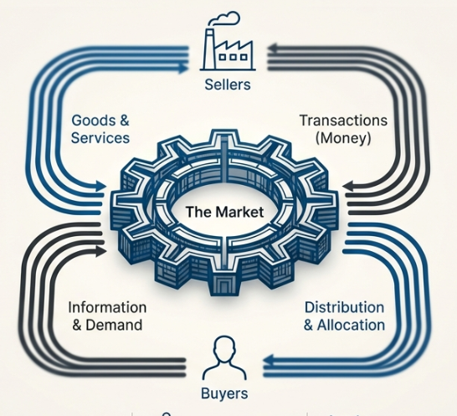
What is a Market?
Group of potential customers
Buyers and sellers interaction
Exchange of goods and services
Physical and digital forms

Slide 4
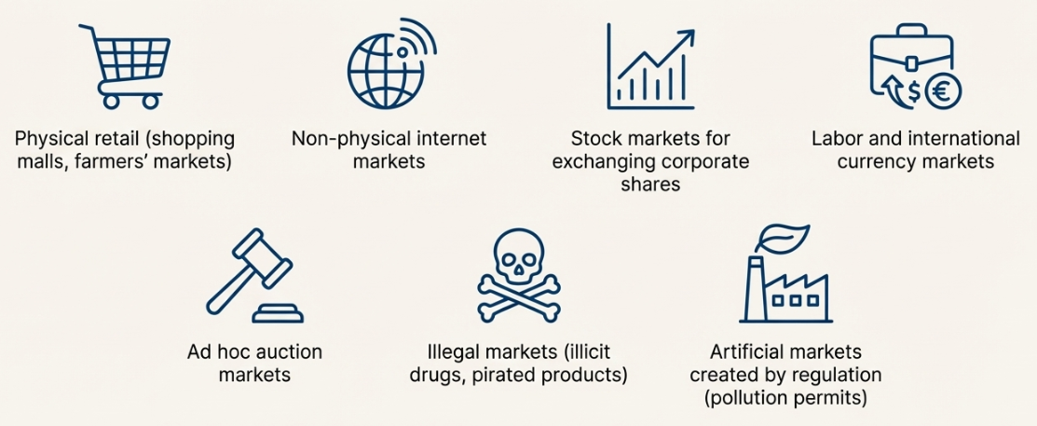
Types of Markets (Real-World View)
Physical retail markets
Online / digital markets
Financial markets
Labor and commodity markets
Regulated and illegal markets

Slide 5
Demand – The Core of Any Market
Desire to buy
Ability to pay
Price sensitivity
Influenced by income & trends

Slide 6
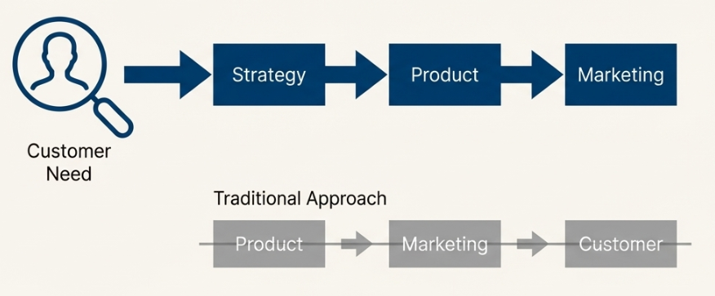
Customer Focus & Market Orientation
Customer-centric approach
Decisions driven by consumer needs
Strategy starts from market
Long-term loyalty creation

Slide 7

Why Market Research is Essential
Understand customer needs
Reduce business risk
Identify opportunities
Beat competition

Slide 8
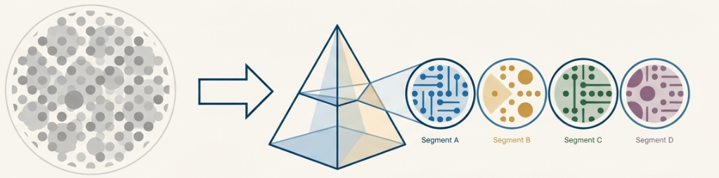
What is Market Research?
Systematic data collection
Customer behavior analysis
Market size & competition
Decision-making support

Slide 9
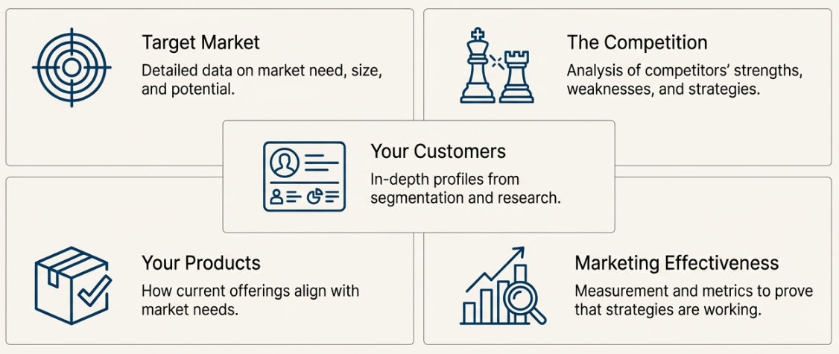
Market Segmentation – One Size Doesn’t Fit All
Dividing market into subgroups
Similar needs and behavior
Better targeting
Efficient marketing

Slide 10
Types of Market Segmentation
Geographic
Demographic
Psychographic
Behavioral
Technology-based

Slide 11
Understanding Market Trends
Upward and downward movements
Changing customer preferences
Technology impact
Competitive dynamics

Slide 12

Market Size & Competitive Analysis
Estimating potential customers
Studying competitors
Understanding substitutes
Measuring effectiveness

Slide 13
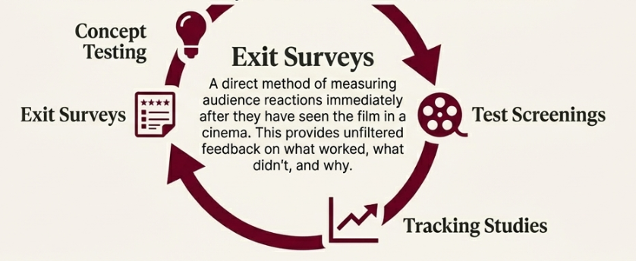
Practical Example – Entertainment Industry
Concept testing
Audience feedback
Promotional testing
Post-launch analysis

Slide 14
Key Takeaways
Market understanding = business survival
Customer is the starting point
Research reduces uncertainty
Segmentation improves focus

Slide 15
Conclusion & CTA
Market needs drive strategy
Foundation of marketing & business
Learn, analyze, adapt

Slide 16


